Slide 1
A few met. highlights before
starting the new RUSSO™ session

Slide 2
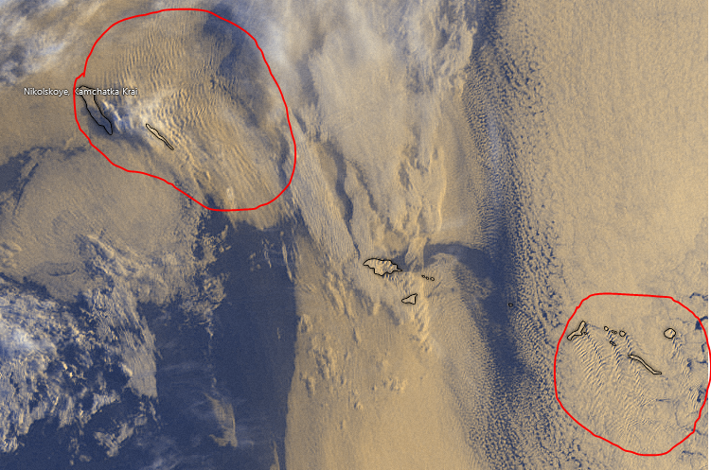
Trapped
Lee
Waves!

Slide 3
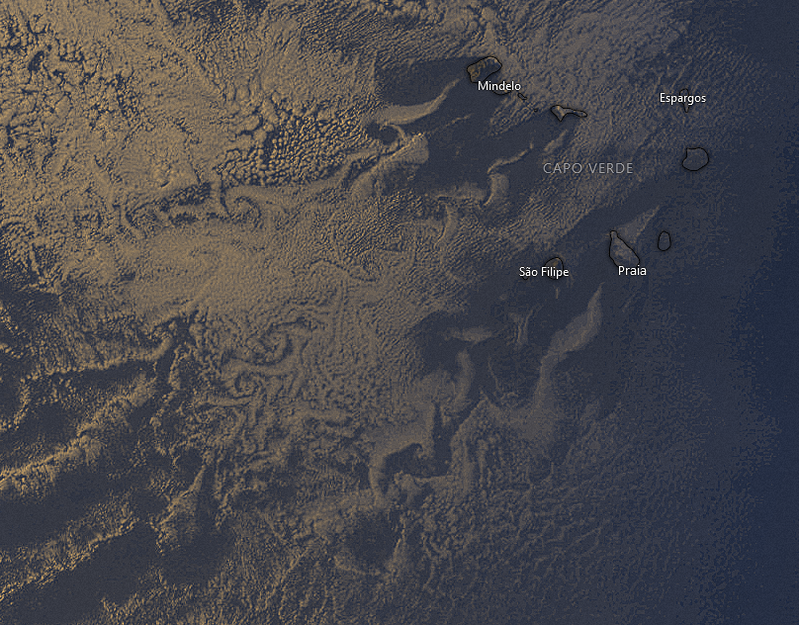
Lee vortices!
DON’T FALL IN THE TRAP:
They are not linked to any «boundary layer separation»

Slide 4
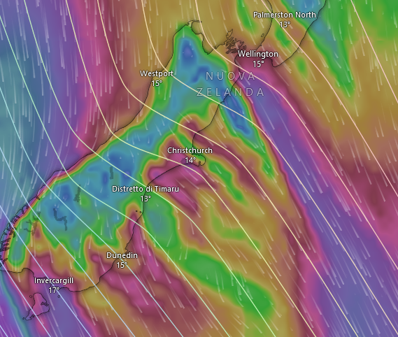
Gap flows!

Slide 5
… actual topic for today:
Reacting to non-Uniform SST cOnditions

Slide 6
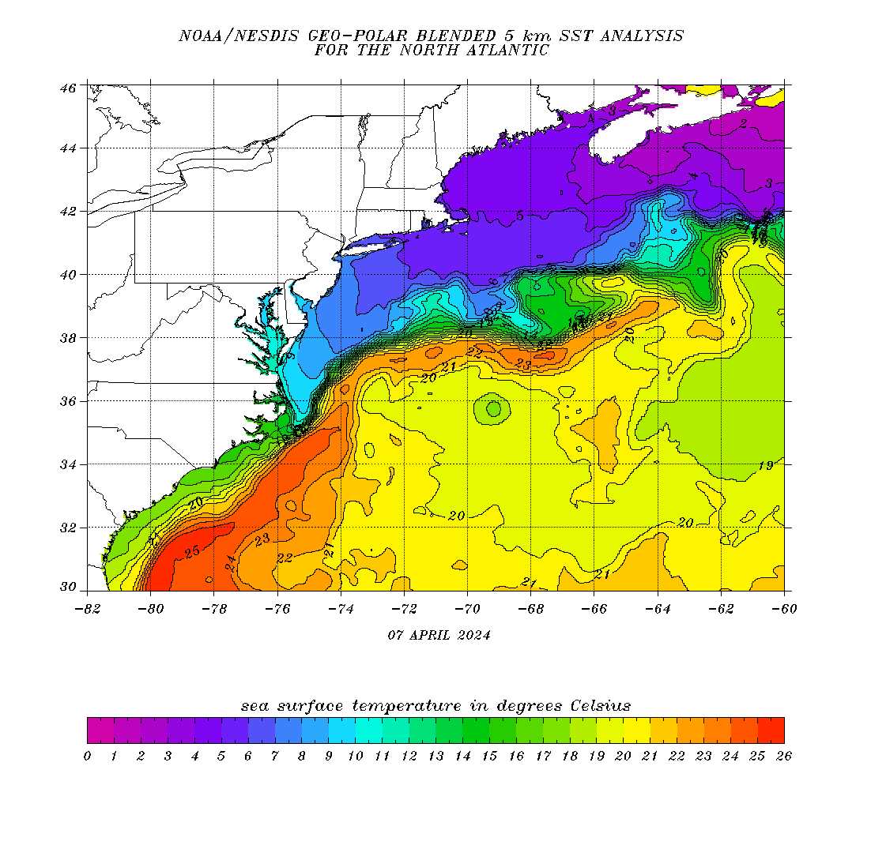
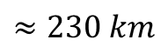
Brief summary on how the atmosphere responds to the strong SST gradients in the Gulf Stream
$$≈230 km$$
Notes:
https://eastcoast.coastwatch.noaa.gov/cw_geopolar_sst.php

Slide 7
GS = strongest example of WBC
26 – 29 degC mxa temps
High seasonal variability
Strongest SST grads in winter as we will see
$$≈230 km$$
Notes:
https://eastcoast.coastwatch.noaa.gov/cw_geopolar_sst.php

Slide 8
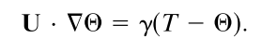
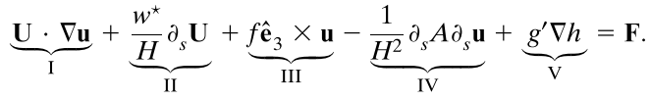
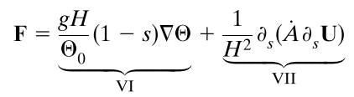
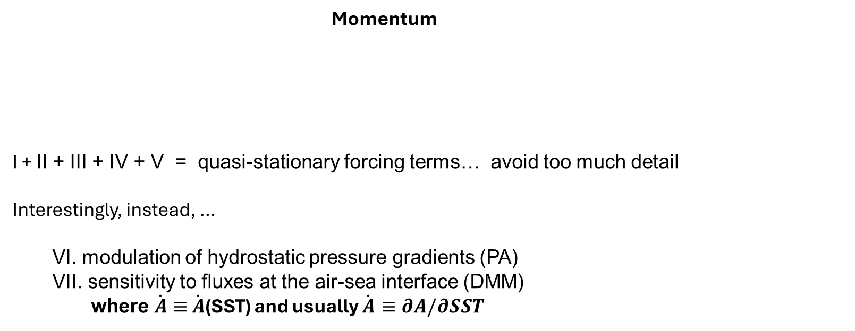
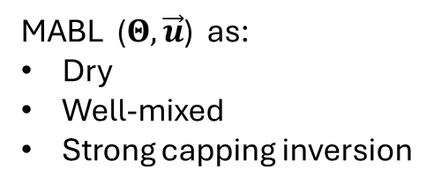
Schneider and Qiu 2015
Thermodynamics
balance between «buoyancy» and large-scale advection
MABL ($Θ, \vec{u}$) as:
Dry
Well-mixed
Strong capping inversion
Momentum
I + II + III + IV + V = quasi-stationary forcing terms… avoid too much detail Interestingly, instead, …
VI. modulation of hydrostatic pressure gradients (PA) VII. sensitivity to fluxes at the air-sea interface (DMM)
where $\dot{A}≡$ $\dot{A}$(SST) and usually $\dot{A}≡∂A/∂SST$
Notes:
SHOULD CHECK ABOUT VALIDITY: IS IT OK TO USE THESE EQUATIONS IN GS CONDITIONS?
I. SST-induced circulation advected by atmospheric mean wind II. vertical advection of LS vertical shear, H height of inversion III. Coriolis IV. divergence of vertical fluxes due to LS mixing V. hydrostatic adjustment of inversion height due to oceanic mesoscale
VI. modulation of hydrostatic pressure gradients (PA) VII. sensitivity to fluxes at the air-sea interface (DMM)

Slide 9
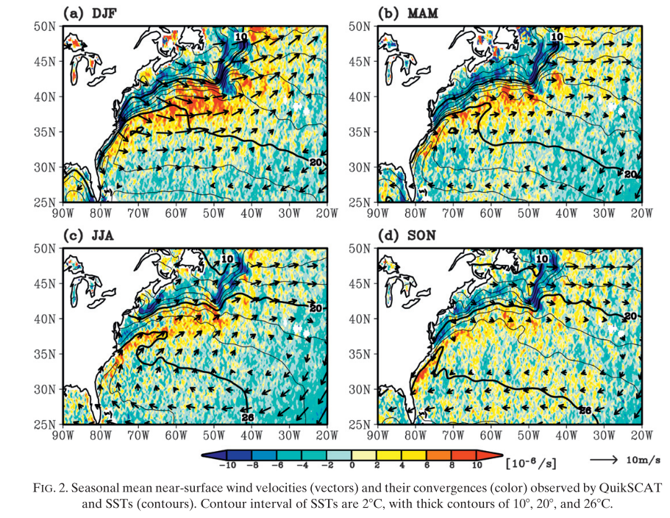
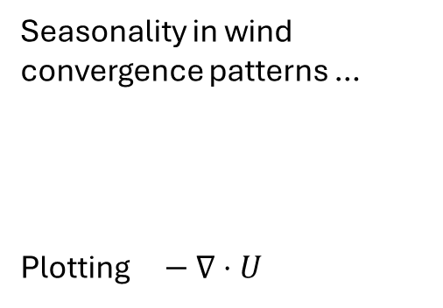
Seasonality in wind convergence patterns …
Plotting $− ∇⋅U$
Minobe et al. 2010

Slide 10
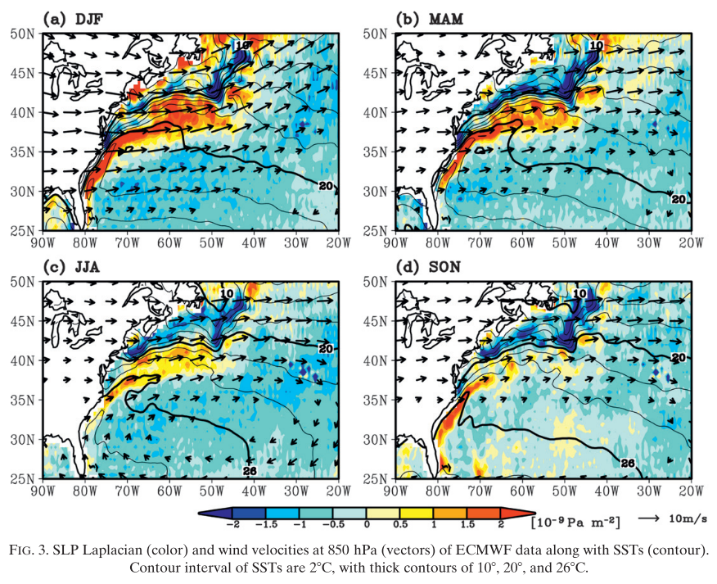
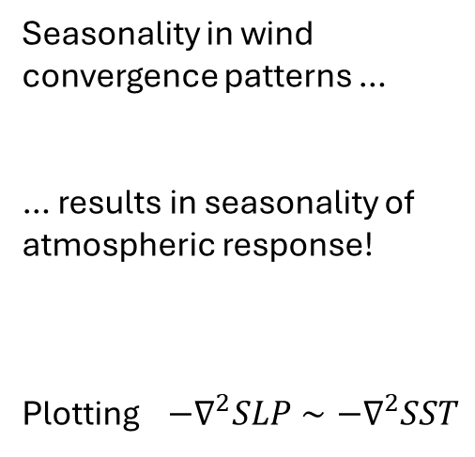
Seasonality in wind convergence patterns …
… results in seasonality of atmospheric response!
Plotting $−∇^{2}SLP∼−∇^{2}SST$
Minobe et al. 2010

Slide 11
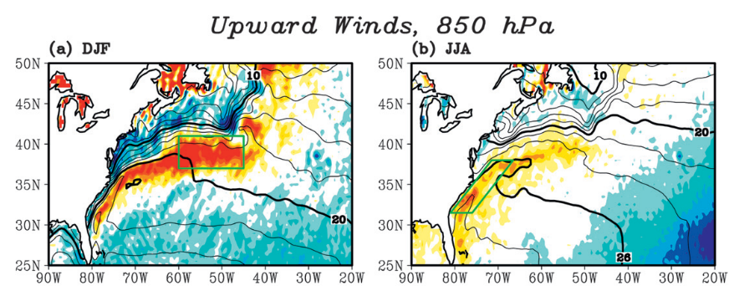
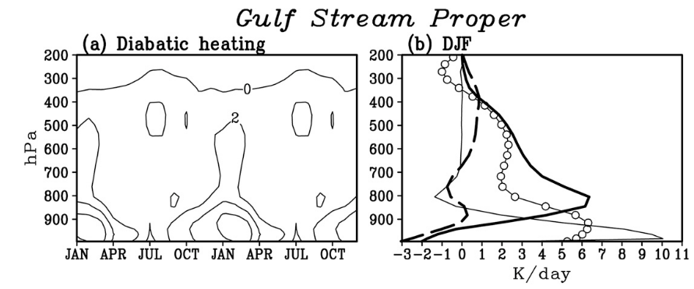
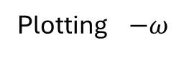
Plotting $−ω$
Seasonality in wind convergence patterns …
… results in seasonality of atmospheric response!
Heating rates from JRA-25/JCDAS from different components:
- Thick black: convective
- white circles: total diabatic
- Thin solid: total sensible
- Thick-dashed: large-scale condensation
-> Shallow convection dominates the scene
Minobe et al. 2010

Slide 12
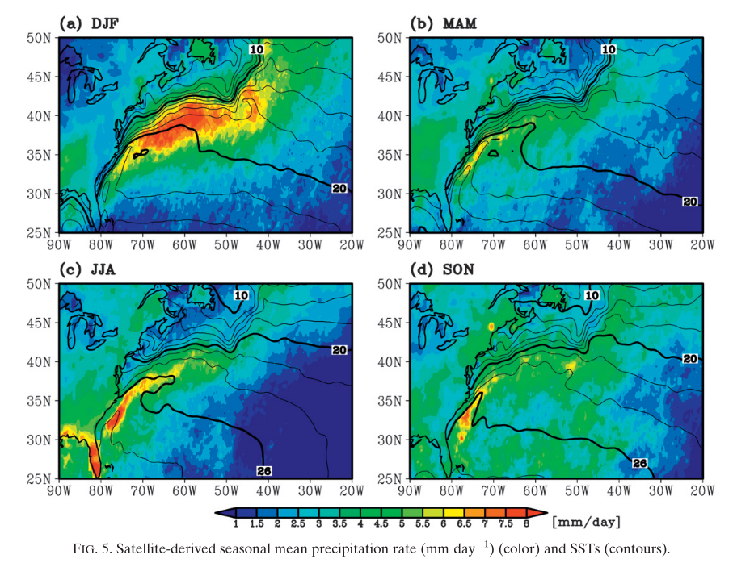
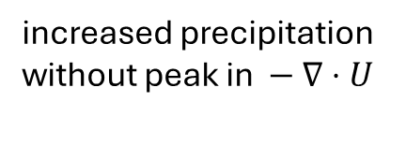
Seasonality in wind convergence patterns …
… results in seasonality in atmospheric response!
… with clear consequences on e.g. precipitation!
increased precipitation
without peak in $− ∇⋅U$
Minobe et al. 2010

Slide 13
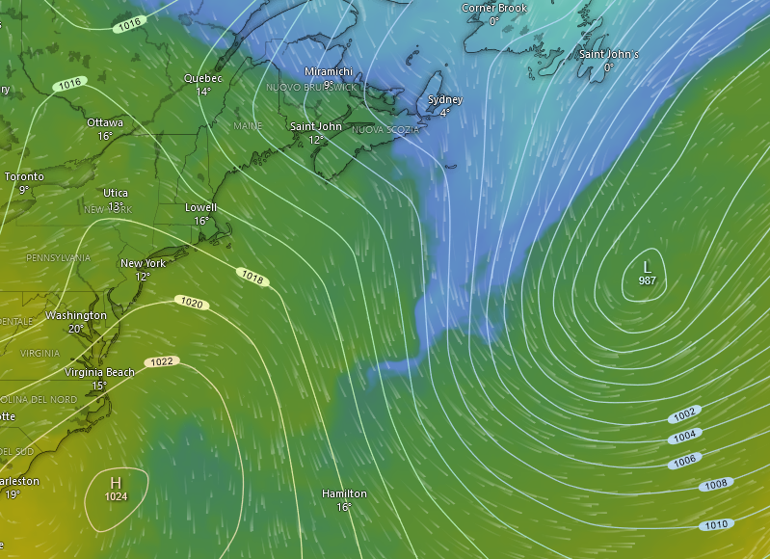
Perfect timing!
MSLP and 850hPa Temperature
09.04.2024 0000Z
Source: windy.com

Slide 14
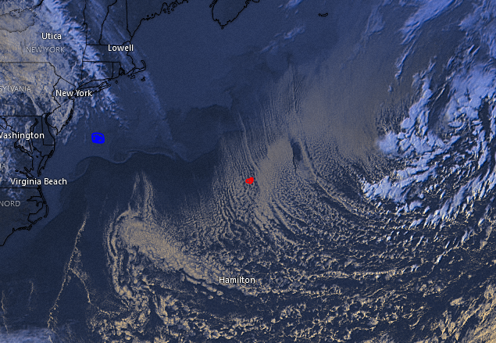
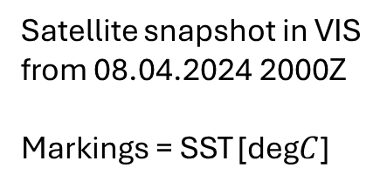
Satellite snapshot in VIS from 08.04.2024 2000Z
Markings = SST [deg$C$]
10
20
Source: windy.com

Slide 15
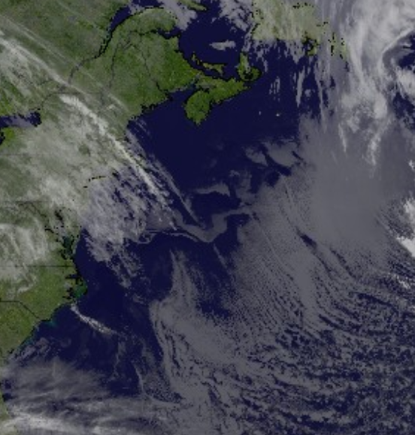
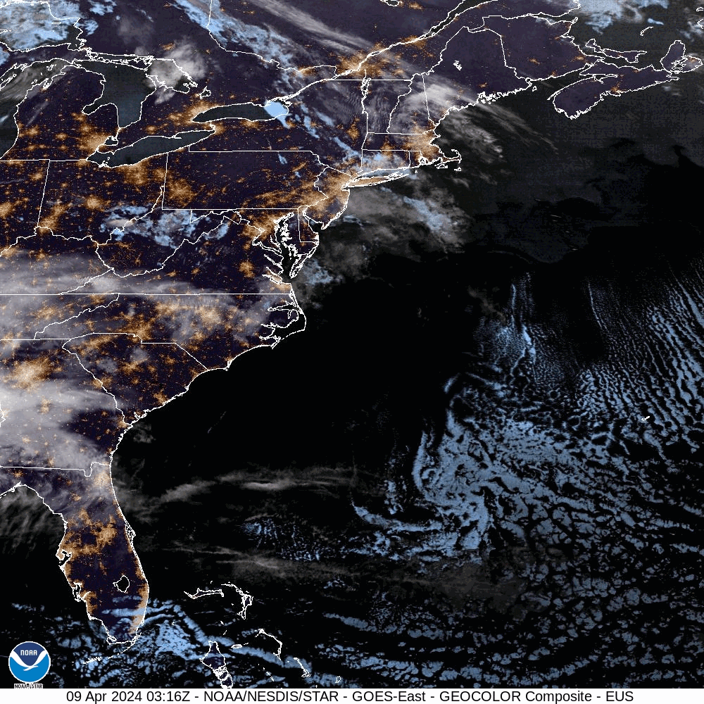
09.04.2024 - Early morning
-> fog patches at the SST front: Northern Wall

Slide 16
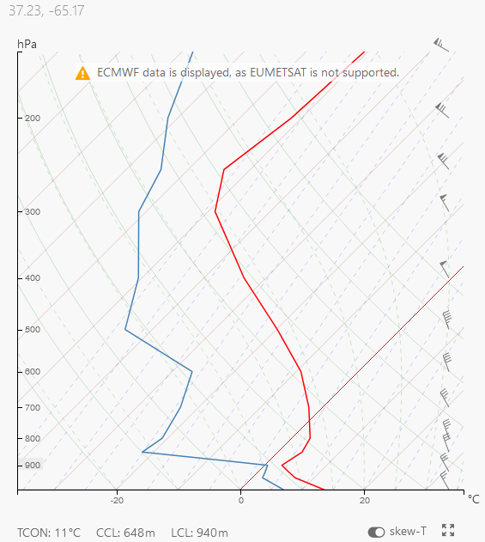
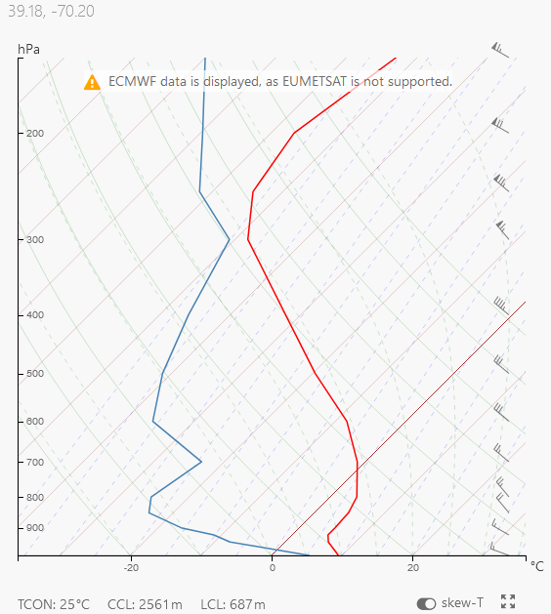
WARM
COLD

Slide 17
Notes:
-> Mechanisms unveiled here are valid for other structures (such as Kuroshio and Agulhas)

